Slide 1

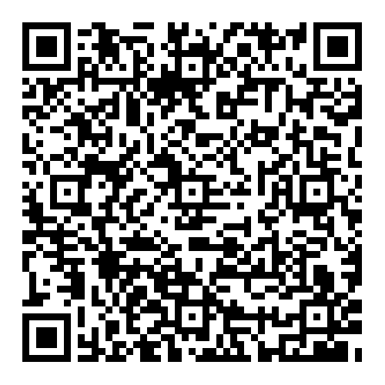
Queues
Demo Lesson
Dr. Michael Robbeloth
Target Course: Data Structures
April 8, 2025

Slide 2
ACM CS 2023 Coverage
Algorithms and Complexity (AL)
Fundamental Data Structures and Algorithms (CS Core: 24 hours, KA Core: 7 hours overall, one hour on queues) pg 18, 31-32
SDF/Fundamental Data Structures (12 core Tier-1 hours), pg. 305
Outcome: Know when to select a queue as an appropriate data structure for a given problem, pgs. 307-308
Outcome: Write programs that use a key abstract data type such as a queue, pgs 307-308
Notes:
March 2023 Beta Guide

Slide 3
ABET Coverage
ABET CAC Criterion 2 & 6
Design, implement, and evaluate a computing-based solution to meet a given set of computing requirements in the context of the program’s discipline.
Apply computer science theory and software development fundamentals to produce computing-based solutions.
ABET EAC Criterion 1 & 7
an ability to identify, formulate, and solve complex engineering problems by applying principles of engineering, science, and mathematics
an ability to acquire and apply new knowledge as needed, using appropriate learning strategies
Notes:
CAC - Computing Accreditation Commission
EAC - Engineering Accreditation Commission
OSU Reference course CSE 2123

Slide 4
Today
Introduction to Queues
Queue Characteristics
Queue Operations
Types of Queues
Queue Implementation
Applications of Queues and Practical Examples
Quiz
Notes:
Recall data structures are concrete implementations of abstract data types
A data type can be mathematically specified or with a programming language w/ operations on objects
ADTs are realized as classes in OOP languages

Slide 5

Lines
“An Englishman, even if he is alone, forms an orderly queue of one.”
George Mikes (British Writer)
Notes:
George Mikes was a Hungarian-born British journalist, humorist and writer, best known for his humorous commentaries on various countries
How to be an Alien

Slide 6
Where have you encountered a wait?

Slide 7

Hurry up and Wait.
Waiting to ride a roller coaster
Waiting at the ATM to make a withdrawal
Waiting in the security line at an airport*
Processing through immigration*

Slide 8
Hurry up and Wait.
You’ve been in a real-life implementation of a queue.
Today, we’ll focus on the virtual ones

Slide 9
So, what is a queue?
A collection of items that are placed into a structure in some order at one end
Removed from the structure at the other end
The entry point is called the tail/rear/back
The exit point is called the head/front
In theory, no storage limits (of course, applied computer scientists have to deal with resource limits)

Slide 10
Today
Introduction to Queues
Queue Characteristics
Queue Operations
Types of Queues
Queue Implementation
Applications of Queues and Practical Examples
Quiz

Slide 11
Queue Characteristics 1/2
A type of sequence (elements in a linear order)
First-in First-out (FIFO) data structure
The item at the front/rear of the queue has been there the longest/shortest
Search (Average/Worst) O(n)/O(n)
Insert/Delete O(1)/O(1) (if linked-list implementation; array is O(n))
Access O(n) (if linked-list implementation; array is O(1))
Space O(n)/O(n)
Notes:
Linear data structure (elements form a sequence)
We have to remove all the elements before the last to get to the last element

Slide 12
Queue Characteristics 2/2
For Java, it doesn’t like to handle null objects in a queue, indicating an empty queue (some implementations may not allow it)
Adding to a full/empty queue is overflow/underflow
Can be used in place of a tape in a Turing machine with two heads moving to the right
Semi-infinite work tape
The leading head is write-only
The right head is read only
Thus, FIFO storage
Can simulate a normal Turing machine (not true of pushdown stores or counters)
Notes:
Linear data structure (elements form a sequence)
We have to remove all the elements before the last to get to the last element
Deterministic Finite Automata simple Turing Machine. Reads input symbols from left to right
Turing machines accept more languages than DFAs can L = {xx : x is a member of {0,1}*}

Slide 13
“How is a queue different from a stack?
FIFO vs LIFO
Stacks are better for undo operations, calculating expressions, and backtracking in algorithms
Interact at rear and front vs just at the front (top)
Notes:
Backtracking is a problem-solving algorithmic technique that systematically explores all possible solutions to a problem in a structured way. It’s particularly useful for problems involving decision-making or searching through complex solution spaces, such as puzzles, games, or optimization problems.
How It Works:
Step-by-Step Exploration: The algorithm starts with an initial solution and progressively builds candidates for the solution step by step.
Constraints Checking: At each step, the algorithm checks if the current candidate satisfies the problem's constraints. If it doesn't, the algorithm "backtracks" by undoing the last decision and tries a different option.
Recursive Process: Backtracking is typically implemented using recursion to systematically explore all paths in the solution space.
Pruning: The process involves "pruning" solutions—discarding paths that cannot lead to a valid solution. This optimizes the search and avoids unnecessary computations.
Example Use Cases:
Sudoku Solver: Tries filling in numbers one cell at a time and backtracks if a number violates Sudoku rules.
N-Queens Problem: Places queens on a chessboard such that no two queens threaten each other, backtracking if a conflict arises.
Maze Solving: Attempts paths in a maze, backtracking when it hits a dead end.
Would you like to see a practical example, say in C or Java?

Slide 14
Today
Introduction to Queues
Queue Characteristics
Queue Operations
Types of Queues
Queue Implementation
Applications of Queues and Practical Examples
Quiz

Slide 15

Enqueue
Adding an element to the rear

Slide 16

Dequeue
Removing an element from the front

Slide 17

Peek (Front)
Look at the front of the queue without removing the element

Slide 18

Empty/isEmpty
Check to see if queue contains any elements

Slide 19

Full/isFull
Unable to accept new elements for enqueueing

Slide 20
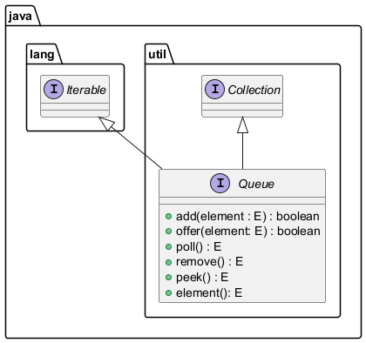
Java Queue Interface
Notes:
Add - Inserts the specified element into this queue if it is possible to do so immediately without violating capacity restrictions, returning true upon success and throwing an IllegalStateException if no space is currently available.
Offer – insert an item into the queue (nicely)
Poll – retrieve and remove head of queue/null
Remove – retrieve and remove head of queue/throws exception if empty
Peek – retrieve but does not remove head of queue/null
Element – retrieve but does not remove head of queue/throws exception

Slide 21
Today
Introduction to Queues
Queue Characteristics
Queue Operations
Types of Queues
Queue Implementation
Applications of Queues and Practical Examples
Quiz

Slide 22
Types of Queues
Linear Queue (Basic)
Circular Queue (Try to limit wasted space)
Priority Queue (Elements are assigned a priority)
Operations: INSERT, MAX, REMOVE, REMOVEMAX, MODIFY, and SIZE
INSERT/MODIFY O(N) given need to find the correct spot in queue for insertion/change (if sorted)
MAX/REMOVEMAX O(N) if unsorted
Double Queue (Deque in Java, insert/remove at both ends)
Notes:
PQ – elements w/ highest priority are removed first.
Knuth would have spoken of deques with/ left and right ends
Heap is an efficient implementation of a priority queue (elements into ancestor/descendant partial order of a binary tree)
Insert could return a reference to inserted element, max could return a reference to a maximum element, and remove will return a reference to item taken out of queue (removemax just does it for the largest), modify keeps item in queue and changes (like someone catching up to their family in a line at an amusement park)

Slide 23
Circular Queue Example with Array
0 1 2 3 4 5 6 7
Queue: 51, 81, 21, 87, 13, 46, 28, blank; Front = 0, Rear = 7, count = 7
After dequeue of 51 (51 is still in queue, but can be overwritten now, just make a copy)
Queue 51, 81, 21, 87, 13, 46, 28, blank; Front=1, Rear = 7, count = 6
After dequeue of 81
Queue 51, 81, 21, 87, 13, 46, 28, blank; Front=2, Rear = 7, count = 5
Enqueue 43 (wrap around of rear)
Queue 51, 81, 21, 87, 13, 46, 28, 43; Front=2, Rear = 0 count = 6 (so index 0 is effectively blank)
Enqueue 22, 91
Queue 22, 91, 21, 87, 13, 46, 28, 43; Front=2, Rear=2, count=8
Notes:
Rear <- (rear MOD QUEUE_SIZE) + 1

Slide 24
Today
Introduction to Queues
Queue Characteristics
Queue Operations
Types of Queues
Queue Implementation
Applications of Queues and Practical Examples
Quiz

Slide 25
Implementation
Think: Buffer/Circular Buffer
Lower Level: Array (fixed) or Singly/Doubly Linked List (dynamic)
Alternative: Double Stack or Stack pointer & Base pointer
Notes:
With an array, might have to keep moving elements except if we use modulo n (size of array) arithmetic to turn an array into a circular buffer
Could also just use a ArrayList implementation w/ Array style and double size when double is expected, preference will suffer due to copies
Stack and Base pointer – use two stacks for enqueueing/dequeuing operations (move all elements from stack1 to stack2 to get to first element inserted and remove; then swap back and forth)
Or… Use the base pointer to track the element at the bottom of the stack and Reverse the stack on dequeue operations.
Enque: Push new elements onto the stack. Adjust the base pointer to always refer to the bottom-most element
Deque: Reverse the stack, then pop the top element. This ensures the FIFO order and Reset the base pointer to the new bottom after the reversal.

Slide 26
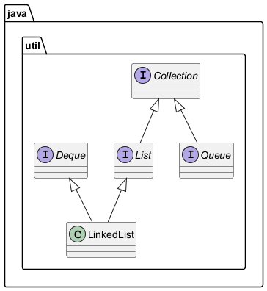
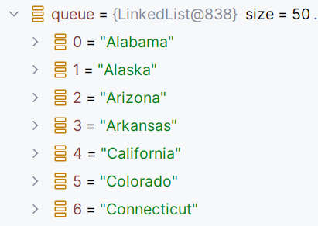
Java Implementation Classes – LinkedList Queue
Notes:
Only something a few implemented interfaces
LinkedList actually implements Serializable, Cloneable, Iterable<E>, SequencedCollection<E>
Show FirstExample

Slide 27
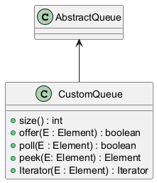
AbstractQueue
Class for the implementation of a minimally viable queue class
CustomQueue here overrides size, offer, pool, peek, and Iterator among other methods
Notes:
Show CustomQueue example

Slide 28
Blocking Queue
Can’t use the regular queue in concurrent operations w/o providing some synchronization mechanism to access them
An alternative is to use a Blocking Queue
Array, LinkedList, Priority variants
Let’s see an example using ArrayBlockingQueue

Slide 29
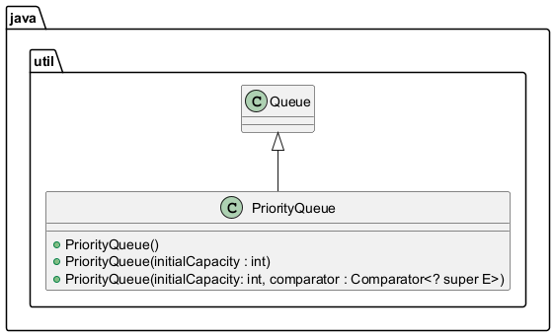
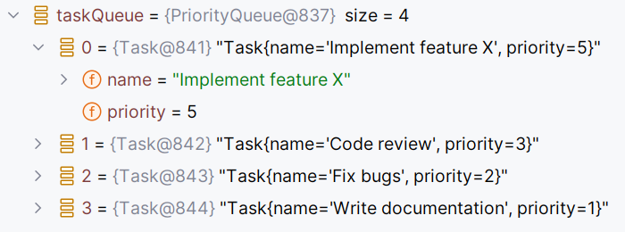
Java Implementation Classes – Priority Queue
Notes:
Only something a few implemented interfaces
LinkedList actually implements Serializable, Cloneable, Iterable<E>, SequencedCollection<E>
Let’s look at the TaskManager Example
Show PriorityQueue Example

Slide 30
Other Interesting Java Queues
DelayQueue – task scheduling, expiry caching, and rate limiting
SynchronousQueue – can’t enqueue an item until another item is dequeued on another thread
There are others…
Notes:
DQ: helps with scheduling jobs where entries need to be held for a certain amount of time before release, rate limiting, and retrieving resources for caching after a certain amount of time has elapsed
See example
SQ: Helps with two components synchronizing with one another

Slide 31
Today
Introduction to Queues
Queue Characteristics
Queue Operations
Types of Queues
Queue Implementation
Applications of Queues and Practical Examples
Quiz

Slide 32

Scheduling
Operating Systems
Ready QUEUES – Use FIFO, Shortest Job Next, or Round Robin
Job QUEUES – Processes awaiting execution
Device QUEUES – Processes needing results of I/O operations
Notes:
Ready queues (processes that are ready to execute, but are waiting for the CPU)
Also priority queues here for certain scheduling algorithms

Slide 33

Print Job Management
Print Jobs go to Spool
FIFO ORDERING
JOBS held until device is ready
Prints jobs one at a time
Notes:
if User A submits a job before User B, User A's document will be printed first, even if User B's job is simpler or smaller
Print jobs go to a spool
Jobs held until device is ready or released (security feature)

Slide 34
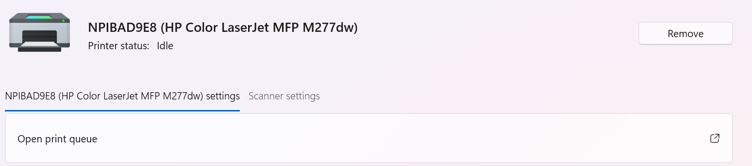
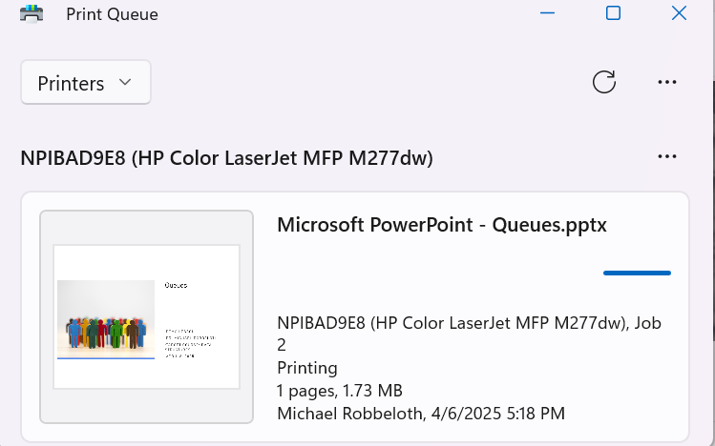
Notes:
Windows 11 Print Queue

Slide 35
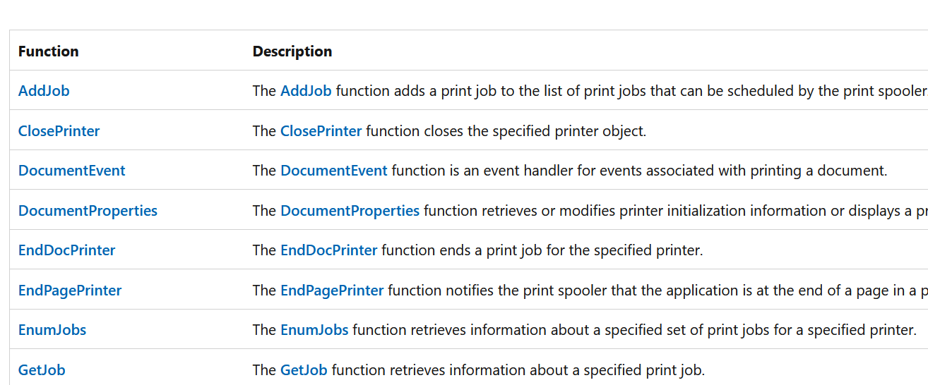
Win32 Print Spooler API Partial List
Notes:
https://learn.microsoft.com/en-us/windows/win32/printdocs/printing-and-print-spooler-functions

Slide 36

Breadth-First Search (BFS)
Graph Algorithms
Visits nodes level-by-level
Visit node, adds unvisited neighbors to the queue
Visits unvisited neighbors in FIFO order
Notes:
Level 0 start node
Level 1 neighbors of the start node
Level 2 neighbors of neighbors
And so on.

Slide 37
Java Messaging Service (JMS)
Used in enterprise messaging (middleware component).
Create, send, receive, and read messages between endpoints
Common set of interfaces and semantics
Asynchronous communication between software components
Loosen coupling between components
Can use publish-subscribe (content hierarchy) or point-to-point (queues) messaging models
Requires a provider like Apache’s ActiveMQ (works with multiple programming languages)
In turn, non-Java/JMS systems can use proprietary APIs like CORBA from OMG to talk to JMS
Notes:
JMS – for example, a sales department application could send a message to a finance department application to issue a bill whenever a sale was made
Show example
In c:\apache-activemq-6.1.6\bin ./activemq start
To see dashboard localhost:8161/admin (admin, admin)
JMS provides flexibility for messaging in enterprise like the use of JDBC for switching database vendors
https://www.oracle.com/technical-resources/articles/java/intro-java-message-service.html

Slide 38
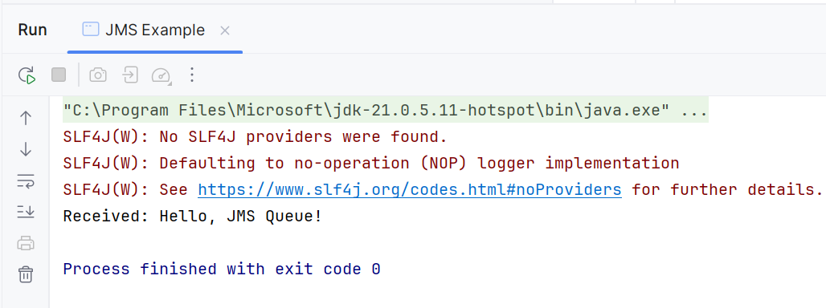
Java Messaging Service (JMS)
Notes:
Client side

Slide 39
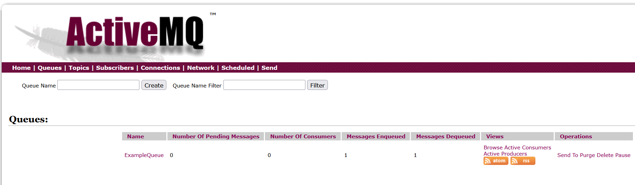
Java Messaging Service (JMS)
Notes:
Server side, note one message dequeued

Slide 40
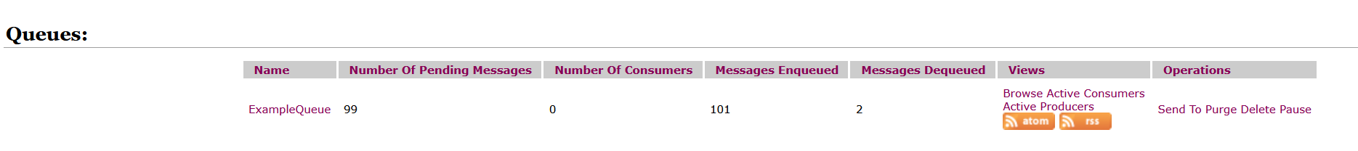
Java Messaging Service (JMS)
Notes:
If I send 100 messages, but only remove one, select Purge I guess

Slide 41
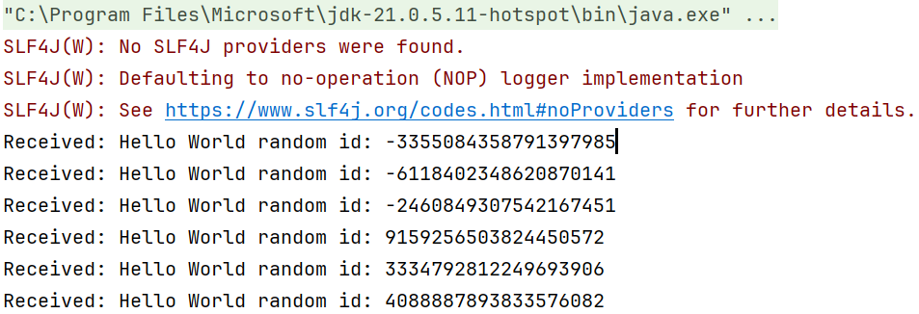
Java Messaging Service (JMS)
Notes:
Sending and consuming 100 messages.

Slide 42

Java Messaging Service (JMS)
Notes:
Sending and consuming 100 messages.

Slide 43
Today
Introduction to Queues
Queue Characteristics
Queue Operations
Types of Queues
Queue Implementation
Applications of Queues and Practical Examples
Quiz

Slide 44
Quiz is in a Kahoot…give me a minute
Notes:
OSU email address

